Slide 1


Ethanol Blends as an Alternative to replace Fossil Fuels
SRM INSTITUTE OF SCIENCE AND TECHNOLOGY
SCHOOL OF COMPUTING
DEPARTMENT OF NETWORKING AND COMMUNICATIONS
Student Reg. No: RA2211031010131
Student Name: Ruchit Shivani
Guide Faculty: Dr. V.M. Gayathri
Designation: Associate Professor Department: Department of Networking and Communications

Slide 2
INDEX
Abstract
Introduction to the Project
Literature Survey
Limitations Identified from the Literature Survey
Research Objectives
Technique to Implement Objectives
Justification of Product SDG
Outcome of Objectives/Output
Conclusion

Slide 3
Abstract
The transition to sustainable energy sources is crucial in mitigating climate change and reducing dependency on fossil fuels. Ethanol blends present a viable alternative, offering a renewable and cleaner-burning fuel option.
The goal of this project is to create machine learning (ML) models to examine patterns in the use of renewable energy sources and worldwide ethanol production trends during the previous 50 years. The study will evaluate the viability, rates of adoption, and effects of ethanol blends on energy sustainability by utilizing historical datasets.
Data-driven policy suggestions and optimization techniques for incorporating ethanol-based fuels into conventional energy systems will benefit from the findings. This project emphasizes how technology is helping to accelerate the worldwide transition to renewable energy, which is in line with Sustainable Development Goal 7 (Affordable and Clean Energy).

Slide 4
Introduction to the Project
The global hunt for sustainable energy alternatives has accelerated due to growing worries about climate change and the depletion of fossil fuel stocks. A possible way to lessen greenhouse gas emissions and reliance on non-renewable resources is through the production of ethanol, a biofuel made from biomass sources like corn, sugarcane, and cellulose. The ability of ethanol blends, which combine ethanol with regular gasoline, to reduce carbon emissions and improve energy security has made them popular worldwide.
By using machine learning (ML) techniques to examine historical data on worldwide ethanol production and renewable energy consumption over the previous years, this study investigates the role of ethanol blends as a feasible substitute for fossil fuels.
This study attempts to shed light on the viability and scalability of ethanol-based fuel systems by looking at important trends, production efficiency, and market adoption rates. By promoting cleaner energy options that may be incorporated into current energy infrastructures, the project supports Sustainable Development Goal 7 (Affordable and Clean Energy).

Slide 5
Literature Survey
S.No | Title | Methodology | Identification of Gaps and Limitations
1 | Machine Learning-Based Molecular Dynamics Studies on Predicting Thermophysical Properties of Ethanol–Octane Blends (Energy & Fuels, Smith, 2024) | - Integrated molecular dynamics simulations with ML models. - Predicted thermophysical properties of ethanol–octane blends. | - Limited to ethanol–octane blends; may not generalize to other fuels. - Requires extensive computational resources.
2 | Forecasting of Engine Performance for Gasoline-Ethanol Blends Using Machine Learning (Journal of Renewable Energy, Patel & Singh, 2023) | - Conducted experimental studies on gasoline-ethanol blend ratios. - Applied ML algorithms to forecast engine performance. | - Focused on specific engine types; results may not apply universally. - Limited consideration of long-term engine wear.
3 | Artificial Intelligence Application in Bioethanol Production (BioEnergy Research, Tanaka & Lee, 2023) | - Reviewed AI techniques applied in bioethanol production. - Emphasized neural networks in optimization. | - Primarily a review; lacks empirical data from new experiments. - Limited discussion on real-world AI integration.
4 | Applications of Machine Learning Technologies for Feedstock Yield Prediction in Bioethanol Production (Energies, Choudhury, 2023) | - Used ML models to predict crop yields for bioethanol production. - Analyzed agricultural inputs and environmental factors. | - Focused on specific feedstocks; may not apply broadly. - Requires high-quality datasets for accuracy.
5 | Artificial Intelligence-Driven Design of Fuel Mixtures (Communications Chemistry, Zhang & Morales, 2022) | - Developed an AI framework to design liquid fuels. - Optimized fuel mixtures for combustion engines. | - Theoretical; lacks validation with real-world testing. - Challenges in industrial-scale application.
6 | Prediction of Gasoline Blend Ignition Characteristics Using Machine Learning (Energy & Fuels, Chen , 2021) | - Compared ML algorithms to predict ignition characteristics. - Developed models to estimate key spark-ignition fuel properties. | - Focused on gasoline blends; limited ethanol application. - Requires large datasets for training and validation.
7 | Machine Learning-Guided Optimization of Biofuel Blends for Enhanced Engine Efficiency and Emission Reduction (Fuel, Kumar & Das, 2024) | - Investigated combustion and emission characteristics of ethanol blends. - Applied ML to optimize blend ratios. | - Limited to specific engines; results may not generalize. - Lacks long-term impact analysis.

Slide 6
Literature Survey
S.No | Title | Methodology | Identification of Gaps and Limitations
8 | Predicting Distillation Properties of Fuel Blends Using Machine Learning (Fuel Processing Technology, Rivera, 2021) | - Used ML models to predict distillation points of gasoline blends. - Trained on refinery data and experimental blends. | - Focused on distillation; doesn’t address emissions or energy content. - Requires detailed compositional data.
9 | Enhancing Autoignition Characteristics with Machine Learning-Powered Fuel Additive Discovery (Combustion and Flame, Yamada, 2021) | - Combined chemical kinetics and ML to predict ignition delay times. - Studied the effects of fuel additives on autoignition. | - Theoretical framework; lacks real engine validation. - Focused on specific biofuels; limited generalization.
10 | Prediction of Liquid Fuel Properties Using Machine Learning Models with Gaussian Processes and Probabilistic Conditional Generative Learning (arXiv, Freitas, 2021) | - Developed ML models using Gaussian processes and probabilistic generative learning. - Predicted physical properties of alternative fuels. | - Focused on fuel density; other properties not explored. - Requires extensive training data for accuracy.
11 | Comparison of Machine Learning Algorithms on a Low Heat Rejection Engine Fueled with Biodiesel-Ethanol Blends (Journal of Renewable and Sustainable Energy, Ahmed, 2023) | - Evaluated various ML algorithms to predict engine performance. - Analyzed biodiesel-ethanol blend effects on low heat rejection engines. | - Specific to low heat rejection engines; may not apply to conventional engines. - Limited blend ratios studied.
12 | Molecular Design of Fuels for Maximum Spark-Ignition Engine Efficiency Using Machine Learning (Energy & Fuels, Johnson, 2022) | - Applied ML models to design fuel molecules for optimal engine efficiency. - Focused on spark-ignition engines. | - Theoretical design; lacks experimental validation. - Specific to spark-ignition engines; may not apply to others.
13 | Artificial Intelligence in Sustainable Aviation Fuel Development (Journal of Energy Resources Technology, Lee & Chen, 2023) | - Reviewed AI applications in developing sustainable aviation fuels. - Highlighted ML techniques in optimizing fuel properties. | - Primarily a review; lacks new experimental data. - Focused on aviation fuels; limited applicability to ground transportation
14 | Machine Learning Approaches for Predicting the Performance of Bioethanol-Diesel Blends in Compression Ignition Engines (Energy Conversion and Management, Silva, 2023) | - Developed ML models to predict performance metrics of bioethanol-diesel blends. - Focused on compression ignition engines. | - Limited to specific engine types; results may not generalize. - Requires extensive experimental data for model training.

Slide 7
Literature Survey
S.No | Title | Methodology | Identification of Gaps and Limitations
15 | Optimization of Bioethanol Production Processes Using Machine Learning Techniques (Renewable Energy, Gupta & Verma, 2022) | - Applied ML models to optimize various stages of bioethanol production. - Focused on fermentation and distillation processes. | - Specific to certain feedstocks; may not apply to all bioethanol sources. - Requires detailed process data for effective optimization.
16 | Machine Learning-Based Prediction of Emission Characteristics in Engines Using Ethanol-Gasoline Blends (Journal of Environmental Management, Rodriguez, 2023) | - Developed ML models to predict emission profiles of ethanol-gasoline blends. - Analyzed various blend ratios and engine operating conditions. | - Focused on specific pollutants; comprehensive emission profiles not covered. - Limited to particular engine models; may not generalize.

Slide 8
Limitations Identified by Literature Survey
1. Data Availability and Model Generalization:
Many studies rely on limited or region-specific datasets, restricting the generalizability of ML models across different geographical and climatic conditions.
Variability in ethanol production methods and fuel compositions introduces inconsistencies that existing models struggle to accommodate.
2. Real-World Validation and Practical Implementation:
Most research is based on theoretical models or controlled laboratory experiments, lacking large-scale real-world validation.
Studies often fail to account for real-world driving conditions, long-term engine performance, and infrastructure challenges in ethanol adoption.
3. Environmental and Economic Considerations:
While models optimize ethanol blends for efficiency and emissions, they rarely consider broader sustainability factors such as land use, water consumption, and lifecycle emissions.
Economic feasibility, government policies, and industry adoption constraints are often overlooked, limiting the practical deployment of ML-optimized ethanol blends.

Slide 9
Research Objectives
Develop ML Models for Ethanol Blend Optimization:
Utilize machine learning algorithms to analyze historical ethanol production and renewable energy consumption data over the past 50 years.
Identify optimal ethanol blend ratios for maximizing fuel efficiency and reducing emissions.
Evaluate the Environmental and Economic Impact of Ethanol Blends:
Assess the carbon footprint, sustainability, and cost-effectiveness of ethanol blends compared to traditional fossil fuels.
Predict long-term benefits and challenges of ethanol adoption in different regions.
Enhance the Practical Viability of Ethanol as a Fossil Fuel Alternative:
Develop predictive models to assess ethanol’s impact on engine performance, wear and tear, and emissions under real-world conditions.
Recommend policy-level strategies for promoting ethanol adoption globally.

Slide 10
Technique to Implement Objectives
1. Data Collection and Preprocessing:
Gather datasets from global sources (IEA, World Bank, national energy agencies) covering ethanol production, renewable energy trends, fuel consumption, and emissions.
Clean and preprocess data to handle missing values, standardize formats, and remove inconsistencies.
2. Machine Learning Model Development:
Implement regression models (Linear, Polynomial, Random Forest) to predict ethanol production trends and energy consumption patterns.
Use clustering algorithms (K-Means, DBSCAN) to segment countries based on ethanol adoption and sustainability metrics.
Train deep learning models (ANN, LSTM) for time-series forecasting of ethanol’s long-term impact.

Slide 11
Technique to Implement Objectives
3. Validation and Optimization:
Compare ML model predictions with real-world ethanol blend test data from research studies and government reports.
Optimize models using feature selection, hyperparameter tuning, and cross-validation techniques.
4. Impact Assessment and Policy Recommendations:
Use ML-driven insights to evaluate the feasibility of ethanol blends in different economic and environmental conditions.
Provide recommendations for policymakers and industries to enhance ethanol adoption while maintaining sustainability.

Slide 12
Justification of Product SDG 7 (Affordable and Clean Energy)
1. Promotes Renewable Energy Integration:
Ethanol blends contribute to reducing dependence on fossil fuels by integrating biofuels into existing energy systems.
2. Reduces Greenhouse Gas Emissions:
ML models help optimize ethanol usage, reducing CO₂ emissions and improving air quality.
3. Encourages Sustainable Energy Practices:
Supports global energy transition efforts by identifying the most efficient and sustainable ethanol blend ratios for widespread adoption.
4. Enhances Energy Security and Economic Stability:
Reduces reliance on oil imports, leading to greater energy independence for countries.

Slide 13
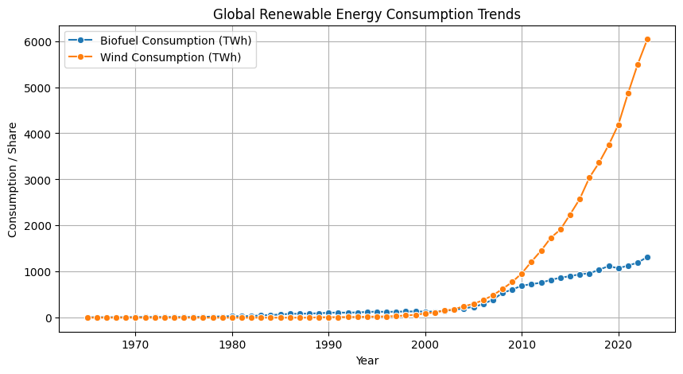
Outcome of Objectives

Slide 14
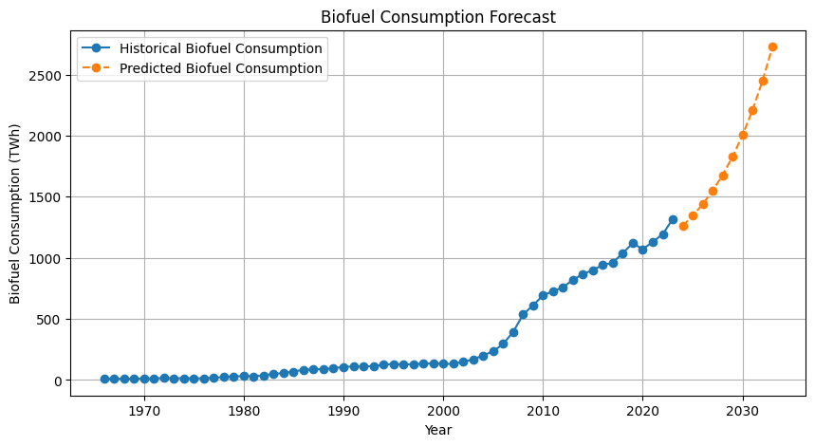
Outcome of Objectives

Slide 15
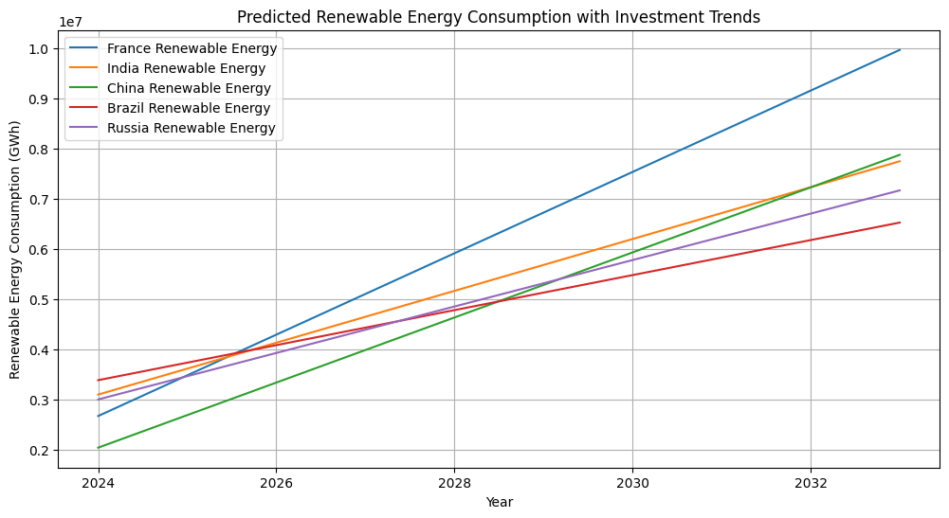
Outcome of Objectives

Slide 16
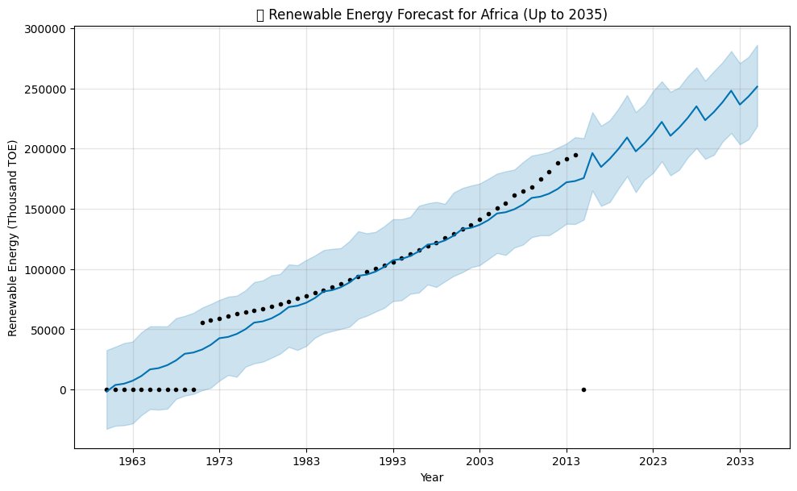
Outcome of Objectives

Slide 17
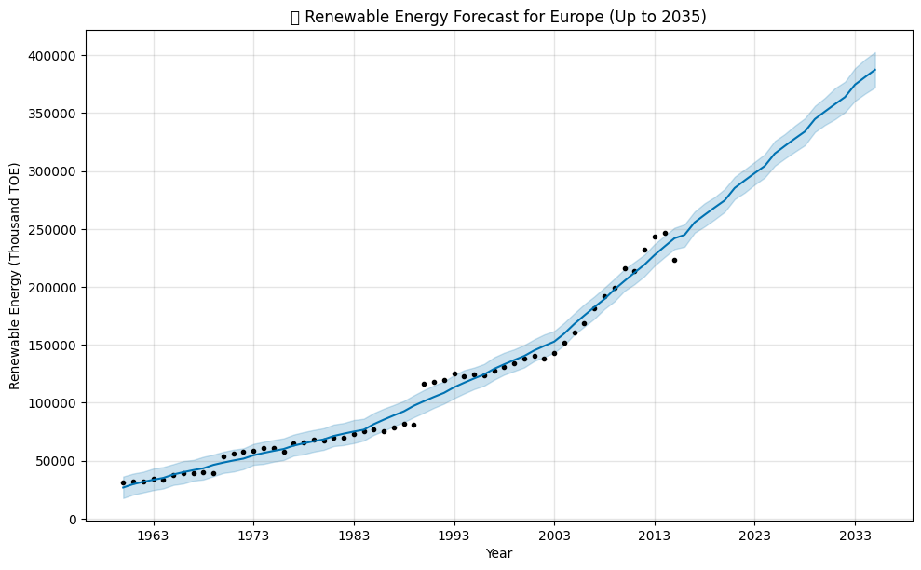
Outcome of Objectives

Slide 18
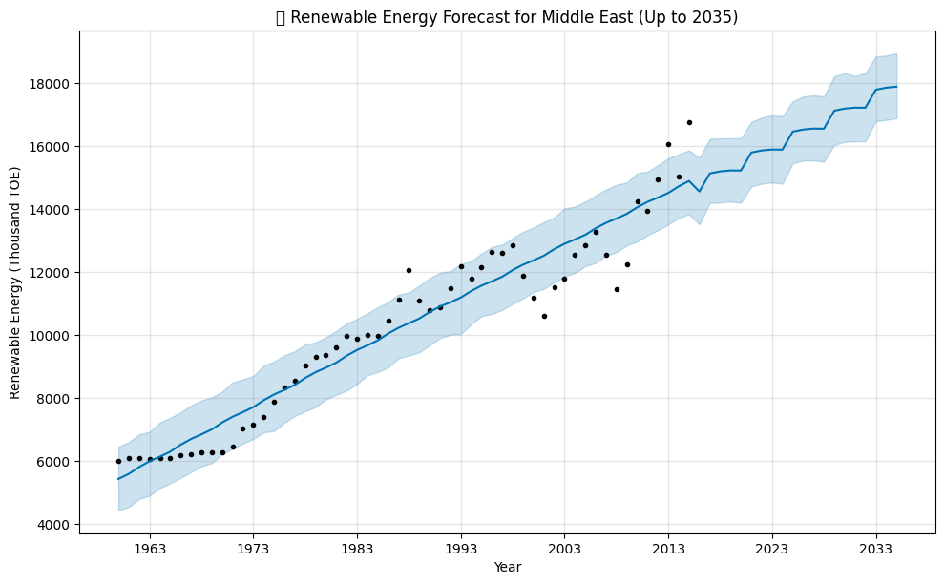
Outcome of Objectives

Slide 19
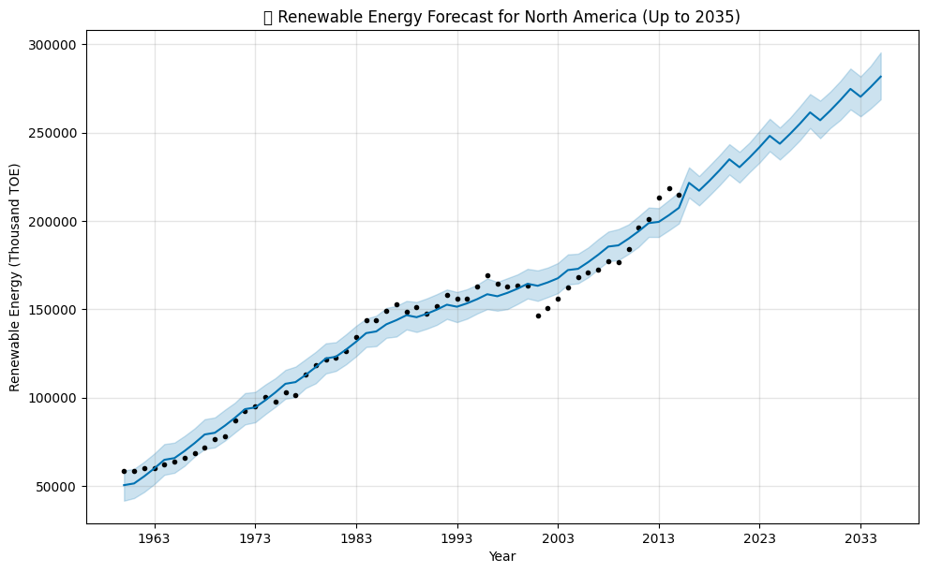
Outcome of Objectives

Slide 20
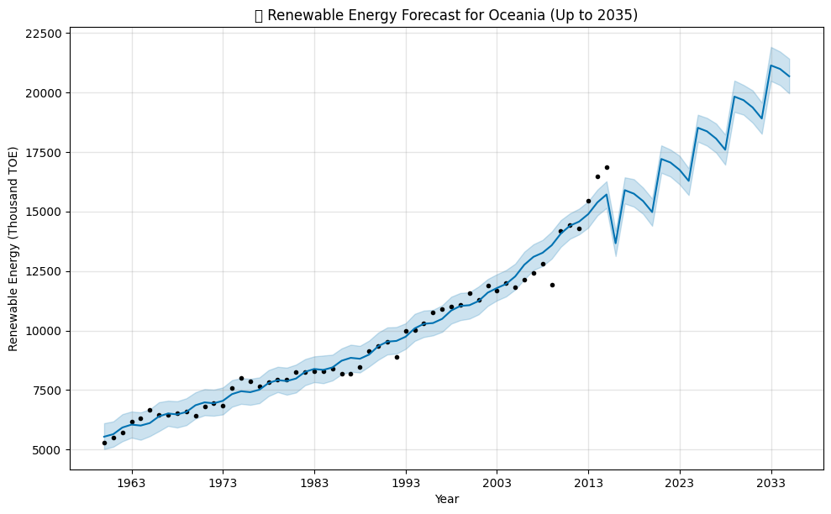
Outcome of Objectives

Slide 21
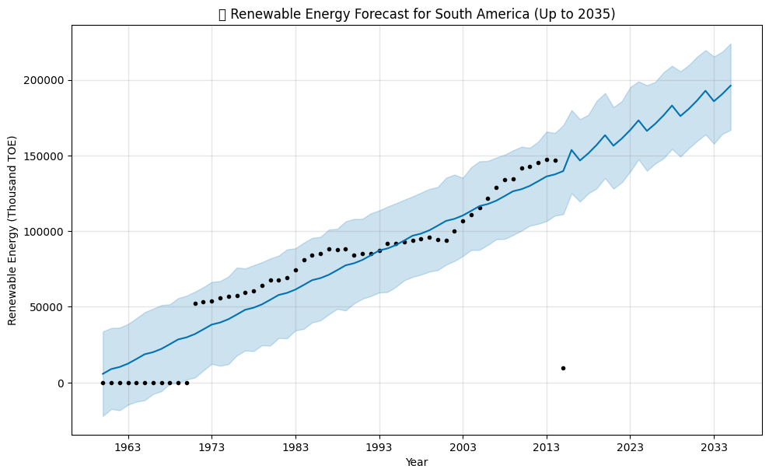
Outcome of Objectives

Slide 22
Conclusion
The analysis highlights ethanol blends as a viable, scalable, and sustainable alternative to traditional fossil fuels.
Through biofuel usage trends, regional classification, and future forecasting, we established a clear picture of global renewable energy dynamics.
Region-wise predictions till 2035 show promising adoption in Asia and South America, with investment patterns supporting growth.
This project lays the groundwork for further studies into energy policy, infrastructure, and market readiness for bio-based alternatives.

